Slide 1
Using Firebase Cloud Messaging to send a push notification to your Android apps with with PyFCM
Notes:
[Mandatory Slide] This would be the introduction slide of the topic that you are covering in this subsection.
When this slide plays, you could talk about the main aim that we’d be covering in this video.

Slide 2
In this Video, we are going to take a look at…
What is Firebase?
Install the sample mobile app
Setup your Firebase account
Setup PyFCM
Code sample
Notes:
[Mandatory Slide]
Before the start of the video, we’d like to highlight what are important topics or pointers that we’d be covering in this video. This slide would immediately follow the intro/name slide. This would just be say 2-3 points for the viewers to know what they are getting into.

Slide 3






What is Firebase?
Firebase is a Google’s “mobile-backend as-a-service”: it provides tools such as databases, authentication provider, storage, analytics and messaging to be used by mobile apps
All of these services are offered in cloud and mostly are freemium
The messaging tool (Firebase Cloud Messaging) is cross-platform and allows users to reliably push messages to mobile apps
ID
Firebase
HEY!
Server program
Mobile app
Notes:
[Mandatory Slide]
Before the start of the video, we’d like to highlight what are important topics or pointers that we’d be covering in this video. This slide would immediately follow the intro/name slide. This would just be say 2-3 points for the viewers to know what they are getting into.

Slide 4
Install the sample mobile app
Developing a mobile app is out of the scope of this video course
In order to run the sample code, you can follow the FCM tutorial provided by Google: https://github.com/firebase/quickstart-android/blob/master/messaging/README.md
You will need:
An Android phone
A USB cable to connect the phone to your computer
The Android Studio IDE (https://developer.android.com/studio/index.html)
Notes:
[Mandatory Slide]
Before the start of the video, we’d like to highlight what are important topics or pointers that we’d be covering in this video. This slide would immediately follow the intro/name slide. This would just be say 2-3 points for the viewers to know what they are getting into.

Slide 5
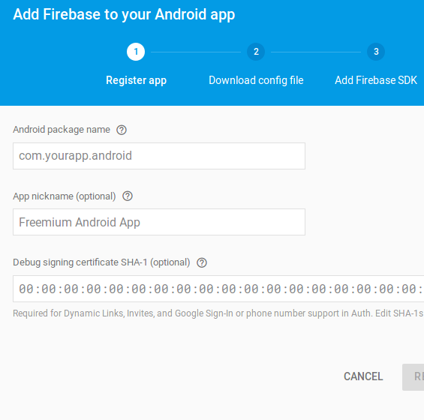
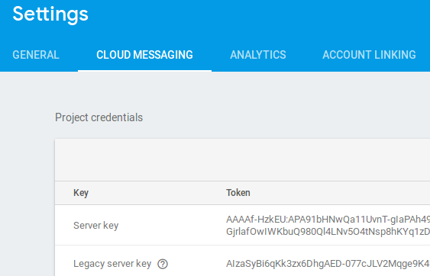


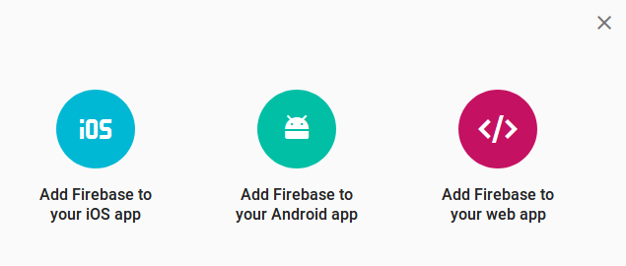
Setup your Firebase account
If you already have a Google account you can use it for Firebase. You might want to create a new project, then open up the Firebase console at https://console.firebase.google.com
Take note of the Server Key that you find under “Settings” → “Cloud Messaging”
Then follow Google’s tutorial: you will be asked to register your mobile app on FCM, which will provide you with a file to be inserted into the source cod of the app
At the end you will need to connect your phone to your computer in debug mode so that the app can be installed and you can obtain the ID with which your device registers to the FCM platform

Slide 6
Setup PyFCM
PyFCM is a client SDK for the Firebase Cloud Messaging API. You can use it to send messages to apps running on Android and iOS devices registered to the FCM platform
Install it with: pip install pyfcm
Notes:
[Mandatory Slide]
Before the start of the video, we’d like to highlight what are important topics or pointers that we’d be covering in this video. This slide would immediately follow the intro/name slide. This would just be say 2-3 points for the viewers to know what they are getting into.

Slide 7
Code sample
Notes:
Something that needs to grab the viewers attention!!

Slide 8
Summary
What is Firebase?
Install the sample mobile app
Setup your Firebase account
Setup PyFCM
Code sample
Notes:
[Mandatory Slide]
Before the start of the video, we’d like to highlight what are important topics or pointers that we’d be covering in this video. This slide would immediately follow the intro/name slide. This would just be say 2-3 points for the viewers to know what they are getting into.

Slide 9
Sending a text SMS via Twilio
with Twilio client
Next Video
Notes:
[Mandatory Slide]
Here the name of the next video needs to be mentioned. The narration as you guessed it would be just letting the viewer know exactly where we are at and what we’d be taking over next! ☺

